Slide 1
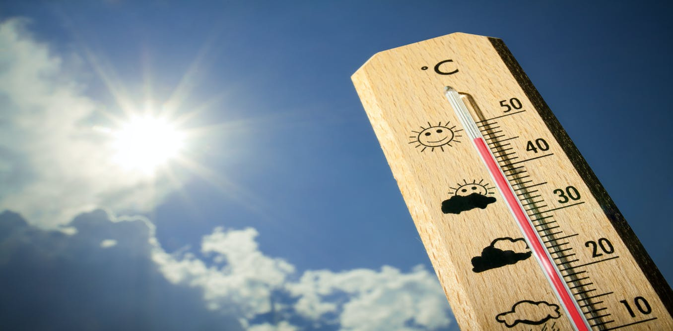
Meteorology section Training Report Directors’ Meeting 2021
Kathy- Ann Caesar
Head of Section

Slide 2
CONTENT
Training Courses – Results and student numbers
The New SLMT
Success and Failures
Moving to virtual training
Upcoming training events
Staff concerns
Support of from the NMHSs

Slide 3
1a - Training Results
Operational Aeronautical Forecasting Course No. 08/21 (July 2021)
Country | Number of Students
Antigua and Barbuda | 1
Barbados | 2
Dominica | 2
Jamaica | 2
St. Kitts | 1
The 2020- 2021 reporting period saw completion and graduation of students from the following WMO vocational training courses offered at CIMH:
All courses were virtual due to the COVID-19 pandemic
Aeronautical Observer Training Course
January 2021 – February 2021
1 student -
Results: Credit
Entry Level Technicians Course No.91/21
March 2021 – July 2021
2 students
Results: 2 Failures
UWI Cave Hill - B Sc in Meteorology Program
Country | Number of Students
January 2021
St. Kitts | 1
Trinidad and Tobago | 1
May 2021
Barbados | 1
Jamaica | 1

Slide 4
1.b Current Academic Year 2021-2022
Mid- Level Technicians Course No.47/21
March 2021 – November 2021
5 students: 2 Barbados, 1 St. Kitts, 2 Saint Lucia
Senior Level Meteorological Technicians’ Course (SLMT) Bridging Course 01/21
September 2021- December 2021
9 students: 2 - Barbados, 1 - Belize, 1 - Dominica, 2 - Jamaica, 1- Sint Maarten, 1 - Saint Lucia, 1 - Trinidad and Tobago.
Aeronautical Continuing Professional Development Course 8/21
September 2021 to March 2022
6 Students – 1 Barbados, 1 Cayman Islands, 2 Grenada,
2 Trinidad and Tobago

Slide 5
1- c UWI BSc. Degree Program: 2021-2022 Meteorology Program
New
Country | Non-Met Office | Met Office
Barbados | 13
Belize | 1
St. Vincent and the Grenadines | 4
Trinidad and Tobago | 2
Total New | 20
Continuing
Country | Non-Met Office | Met Office
Antigua and Barbuda | 1 | 1
The Bahamas | 1 | 2
Barbados | 30
Dominica | 1
Grenada | 1
Jamaica | 4
Saint Lucia | 1
Trinidad and Tobago | 3
Total Continuing | 42 | 3
Total | 62 | 3
Total number of Students |  | 65
METE1110 Introduction to Oceans & Climate: 39 students _
METE1125 Meteorological Observations, Instruments, and Basic
Analysis: 7 students
METE1130 Introduction to Physical Meteorology: 7 students
METE2110 Atmospheric Thermodynamics: 13 students
METE2125 Dynamic Meteorology: 15 students
METE2305 Fundamentals of Hydrometeorology: 11 students
METE3110 Advanced Dynamic meteorology: 7 students
METE3210 Advanced Synoptic Meteorology: 5 students
METE3215 Synoptic Meteorology Lab II: 1 student
METE3410 Radar Meteorology: 1 student
NOTE –
Four Leve 2 students are repeating – 3 for the second time
ALL but ONE of the students at Level 3 are repeating
Notes:
Similar observations are seen in the UWI programme as well. This year only one student was able to move from Level-2 to Level-3. And 7 out the 11, Level-3 students failed to complete their course load to graduate.
In large part the performance of students was a result of attitude towards their work and the study habits.
There was some good news in terms of the UWI students’ performance in the Mathematic classes. All but one of the Level 1 meteorology students were able to matriculate to Level 2. Resulting in full class sizes at that level. The Section is working with these students to mentor them through the problem. Unfortunately, due to the COVID-19 pandemic, all of these students worked from home, and this has resulted in a lack of maturity that is normally observed at this level of university.
BAD NEWS
Only one student was able to move from Level-2 to Level-3.
Seven out of the 11 Level-3 students failed to complete their courses to graduate.
3 of the failing students are from Meteorological Services.
Poor performance of students was a result of
Poor attitude towards their work and the study habits
Poor mathematics skills
Poor understanding of basic meteorological concept
GOOD NEWS
Good news in terms of the UWI students’ performance in the Mathematic classes.
All but one of the Level 1 meteorology students matriculate to Level 2.
The Section is working with these students to mentor them through the problem.
Unfortunately, due to the COVID-19 pandemic, and with students working from home, they lack of maturity that is normally observed at this level of university.

Slide 6
2a - Senior Level Meteorological Course 2022
After objections were raised at 2020 Directors’ Meeting over the New SLMT - Blended Course proposal CIMH arranged subsequent meetings with the CMO Directors.
The following are the summary points of the January 26th meeting.
There was a need for a SLMT course in 2022.
It was agreed that any restructuring of the CIMH SLMT programme, should not impact the competence of the graduates. Rather, any change should improve the quality of the programmes and the competence of graduates.
It was noted due to the COVID-19 pandemic, the conversation of most of its courses to a blended (virtual/face-to-face combination) format was accelerated.
To ensure the competency standards of the online and blended courses were adhered to, it will require that the NMHSs actively and directly support the training programmes.
It was recommended that NMHSs identify a Liaison officer who would be assigned for each Level of training going forward.
An inquiry was again made into having a shortened SLMT course for persons with a BSc degree in either Math or Physics. Again CIMH, noted that due to constraints teaching UWI and SLMT simultaneously, along with staff limitations made the difficult.
The incoming qualification of SLMT candidates was raised.
At best the incoming level of Caribbean Advanced Proficiency Examination (CAPE) Mathematics and Physics similar to UWI
CIMH noted that the Caribbean Secondary Education Certificate (CSEC) level will remain as the prerequisites, until all CMO Member States are able to meet this minimum requirement.
CIMH was tasked with producing a description of the NEW SLMT proposal with one additional options
Notes:
The proposed new structure will first attempt to ensure a better success of the SLMT candidates by addressing any gaps in their backgrounds in Mathematics and Physics through the Pre-assessment which are the foundation subjects of the SLMT course. Secondly, by maintaining the 15-month teaching period, there is no threat to reducing or rushing the standard curriculum. Finally, with the Face-to-Face component now reduced to 11 months, from September (even year) to July (odd year), the cost to Regional Meteorological Service should be significantly decreased.
However, there were objections to the 18-month proposal and further discussion was requested between CIMH and the CMO Directors on the matter. There were a further two meetings in January and later in March, to vote on the final proposal.
The following is a summary of the January meeting.
• There was a need for a SLMT course in 2022.
• The Directors and the CIMH agreed that any restructuring of the CIMH SLMT programme, should not impact the competence of the graduates. Rather, any change should improve the quality of the programmes and the competence of graduates.
• The CIMH explained that because of the COVID-19 pandemic, the conversation of most of its courses to a blended (virtual/face-to-face combination) format was accelerated. This will not only reduce the cost of training and will accommodate those students who may be unable or unwilling to travel.
• CIMH indicated that to ensure the competency standards of the online and blended courses were adhered to it will require that the NMHSs more actively and directly support the training programmes.
• It was recommended that NMHSs identify a Liaison officer who would be assigned for each Level of training going forward.
• An inquiry was again made into having a shortened SLMT course for persons with a BSc degree in either Math or Physics. Again CIMH, noted that due to constraints teaching UWI and SLMT simultaneously, along with staff limitations made the difficult.
• The incoming qualification of SLMT candidates was raised. It was noted that it would be best if the incoming level of Math and Physics be raised to the Caribbean Advanced Proficiency Examination (CAPE) level, like that of UWI. This could ensure that students are better prepared to take the course when they enter the programme. However, CIMH noted that it will remain at the Caribbean Secondary Education Certificate (CSEC) level, until all CMO Member States were satisfied and are able to meet this minimum requirement.
• CIMH was tasked with producing a description of the NEW SLMT proposal with one additional option.

Slide 7
2b- Senior Level Meteorological Course 2022
The New SLMT Proposal - Blended Course over an 18-month period.
The new course will be essentially in three periods.
Bridging Course – September to December 2021 – (Started with 9 students)
The COMET Bridging Course in Mathematics Physics and General Meteorology
Self-paced and MUST PASS Pre-assessment.
ALL CANDIDATES MUST TAKE THE PRE-TEST TO MOVE ON TO THE SLMT COURSE
Virtual Section – January to July 2022
Synchronous virtual classes.
MUST have a passing grade in the CORE courses to move
Face to Face Section – September 2022 to July 2023
In person at CIMH
Including the FOS
The Face to Face component -11 months (9 teaching months), from September 2022 to July 2023
For this course to be successful in any format, candidates:
Cannot be working while on the course
Must have the proper administrative support, before, after, and during the course.
Students Must have a proper attitude towards their own success.

Slide 8
2c - Proposed SLMT Options
Applicants with BSc degree in Meteorology (2.5 GPA or higher) –
Similar to the Operational Aeronautical Forecasters’ Course.
Training period -2 to 3 months, with a recommended operational training or On-the-Job-Training of 4 to 6 months.
Risks: The pool of candidates will be small and may favour the larger CMO Member States.
Applicants with BSc degree in Mathematics or Physics:
Training period 15 months, with a recommended operational training of 4 to 6 months.
Risks: The pool of candidates will be small and may favour the larger CMO Member States.
CIMH ELMT and MLMT candidates from 2011 and beyond.
Candidates with CAPE Maths (Unit 1 and Unit 2) and CAPE Physics (Unit 1) can also be eligible. But will need to take General Meteorology.
Training period 18 months, with the Bridging course in place.
Risks: This will always be a lengthy option and cannot be less than 15 months.
A stand-alone SLMT forecasters’ course.
There need to be more lecturers at CIMH to separate the UWI programme from the SLMT.
The programmes cannot run concurrently with the current staff complement to achieve the required reduced delivery time.
A proposed option will be to have a shortened SLMT course run every three years when it will be the only CIMH aeronautical meteorological course offered. That is, there will be no other CIMH Aeronautical (i.e., no ELMT or MLMT)
Notes:
CIMH is considering putting the following in place:
Applicants with BSc degree in Meteorology (2.5 GPA or higher)
These candidates will have the appropriate BIP-M qualifications and only require the training in the Aeronautical Meteorology and forecasting required competencies by taking the Operational Aeronautical Forecasting Course.
Training will be reduced to 2 to 3 months, with a recommended operational training or On-the-Job-Training of 4 to 6 month. This is in line with most other WMO RTCs.
Risks: The pool of candidates will be small and may favour the larger CMO Member States.
Applicants with BSc degree in Mathematics or Physics:
These candidates will need the BIP-M qualifications and the Aeronautical Meteorology training and required competencies.
Training will be reduced to 15 months, with a recommended operational training of 4 to 6 month. Due to the requirements of the UWI programme and staff workload concerns. Recall the UWI course load is more given the 3-credit transition. This has all academic meteorology lecturers heavily engaged. This together with required term limits on teaching sessions make it difficult to have a short course period unless new human resources are made available.
Risks: The pool of candidates will be small and may favour the larger CMO Member States.
Follow the WMO recommended training track where SLMT candidates are accepted from the ranks of the pool of MLMT from the NMHS.
Graduates from the CIMH ELMT and MLMT course over the last 10 years have the compliant prerequisite General Meteorology, Mathematics and Physics to follow on to a SLMT course.
Candidates with CAPE Maths (Unit 1 and Unit 2) and CAPE Physics (Unit 1) can also be eligible. But will need to take General Meteorology.
All States should be able to recruit in-house
With time this option could be reduced to 15 months with the Bridging course in place.
Risks: This will always be a lengthy option and cannot be less than 15 months.
A standalone SLMT forecasters’ course.
There need to be more lecturers at CIMH to separate the UWI programme from the SLMT. The programmes cannot run concurrently with the current staff compliment to achieve the required reduced delivery time. Until this is realized the SLMT course can be no shorter that 15 months.
A proposed option will be to have a shorten SLMT course run very three years, when it will be the only CIMH aeronautical meteorological course offered. That is, there will be no other CIMH Aeronautical (i.e., no ELMT or MLMT)

Slide 9
3- The Aeronautical Observer Training Course vs Entry Level Meteorological Technicians’ course
ELMT
AOTC
Note the ELMT has more academic components;
There were above normal instances of absenteeism, late to classes, leaving class in the middle of lectures, and sleeping in class
Note, the students were assessed to be academically capable but poor attitude hurt significantly.
There were eleven (11) subject failures.
The notable challenges encountered in executing the Practical classes
Despite constant and repeated consultations with the liaison officer.
Practical work of the ELMT not fully assessed by the CIMH trainers because students’ “in-office” work and practical exam, to date were not received.
Both Students failed
The lone student was active and attentive throughout and very willing to learn.
Despite a medical emergency, early on, the student never missed classes ;
A very important aspect was the support provided by the senior meteorological observers (SMO) – as the liaison of the Service
The involvement of and discussions with the SMO on matters of concern, provided the required on-site guidance from experienced observers, to assist CIMH trainers to competently train newly recruited trainee.
The Service also allowed access to the real-time digital observations allowing accurate assessment of the students’ observations
The student achieved a Credit.
Notes:
Student performances were below previous course achievements. The class averages ranged from a high of 63% to a low of 51%; compared to 79% to 64% in the last course
The CIMH was contracted in 2021 by the Bermuda Weather Service to conduct: (1) Aeronautical observer training and independently assess a new staff, (2) 'refresh' the more experienced staff, and (3) provide observing cover during the training period Mr Lawrence Andrew Doughty, the lone student was active and attentive throughout and very willing to learn. He achieved a Credit. A very important aspect to his success was the support provided by senior meteorological observers of the Bermuda Weather Service, in particular, Ms. Dana Masters, whose involvement and discussions on matters of concern provided the required on-site guidance from experienced observers, to assist CIMH trainers to competently train newly recruited trainees. The Bermuda Weather Service also allowed access to the real-time digital observations allowing accurate assessment of the Mr. Doughty observations. These were critical aspects of the virtual training to ensure competency.

Slide 10
4 -The issues with virtual training
Virtual and Blended Learning is HERE TO STAY
BUT CHANGES at ALL Levels is Required for Success
Notes:
Contributing factors to students’ poor performances
Poor time management, attitude and distractions,
Students on the road (driving) during class time.
Student tardiness and absenteeism
Failure to review the necessary the resource materials.
Some students also had device and internet issues
In these cases, the students were urged to seek support from their National Meteorological Services.
For the first time in CIMH History there was no graduation following a course.
The MLMT students are not in such predicament at this phase, since they have not yet started the core subjects of their program.

Slide 11
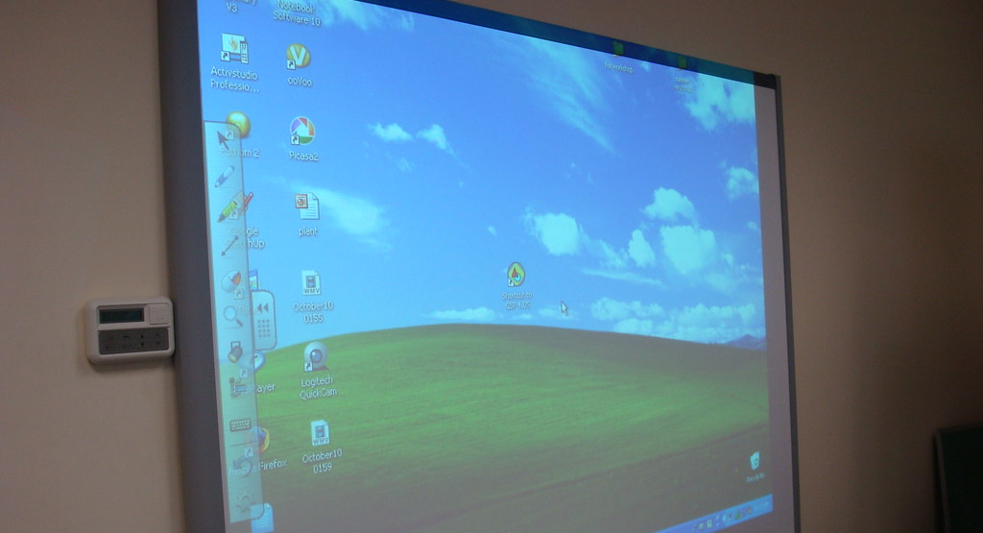
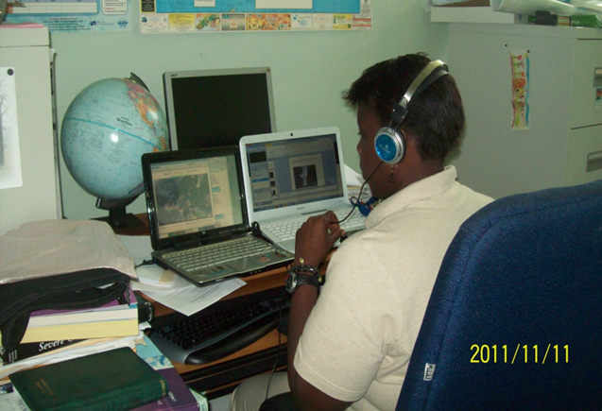
This Photo by Unknown Author is licensed under CC BY-SA
This Photo by Unknown Author is licensed under CC BY-NC
Notes:
Long History for virtual training events – In 2003, the VLab Regional Focus Group monthly discussion was started at CIMH, and now has spread across the World.
In 2010, Ms Kathy-Ann Caesar and Mr Shawn Boyce worked with COMET on the implementation of an online course- the results AeroCPD, now in its 8th offering and the Hydrological and GIS virtual courses.
The CIMH staff have taken part in ALL WMO ETR Train – the Trainers courses, and Some of CIMH graduates now serve as WMO lecturers.
CIMH has collaborated in the production and design of four COMET modules.
CIMH has certified trained staff in Education
CIMH is by good technical support, including mycimh Moodle. Zoom VoIP software, SMARTBoard in every classroom
the Principal has provided and continues to support additional resources if and when needed.
The COMET consulting team just completed a comprehensive review of the CIMH virtual training capabilities and the initial report confirms that the CIMH staff is well trained and the report has positive recommendations for continued improvements.

Slide 12
CIMH Preparations for Virtual training
Long History for virtual training events – In 2003, the VLab Regional Focus Group monthly discussion was started at CIMH, and now has spread across the World.
In 2010, Ms Kathy-Ann Caesar and Mr Shawn Boyce worked with COMET on the implementation of an online course- the results AeroCPD, now in its 8th offering and the Hydrological and GIS virtual courses.
The CIMH staff have taken part in ALL WMO ETR Train – the Trainers courses, and Some of CIMH graduates now serve as WMO lecturers.
CIMH has collaborated in the production and design of four COMET modules.
CIMH has certified trained staff in Education
CIMH is by good technical support, including mycimh Moodle. Zoom VoIP software, SMARTBoard in every classroom
The Principal has provided and continues to support additional resources if and when needed.
The COMET consulting team just completed a comprehensive review of the CIMH virtual training capabilities and the initial report confirms that the CIMH staff is well trained and the report has positive recommendations for continued improvements.
Notes:
What have we done for you lately

Slide 13
The Stresses on Online Learning Are Students Prepared?
Despite initial enthusiasm, many students fall off in their performance in the virtual learning format
MAJOR Distractions –
They are working from HOME
They are other devices, activities
They are being CALLED out to WORK.
POOR Mathematics and English Skills
This continues to be a problem
Sense of Entitlement – Poor attitude
Especially at the UWI level
Demanding changes (e.g., recordings) with no effort to work on their part
CHEATING and Plagiarism
MAJOR issue – Students at CIMH can and will FACE expulsion if found cheating
Lack of proper computer Software/ Hardware and internet access
As many as two students per course have consistent issues
The COVID Factor
Due to the COVID-19 pandemic, and with students working from home, they lack the maturity that is normally observed at this level of the University.
Notes:
Similar observations are seen in the UWI programme as well. This year only one student was able to move from Level-2 to Level-3. And 7 out the 11, Level-3 students failed to complete their course load to graduate.
In large part the performance of students was a result of attitude towards their work and the study habits.
There was some good news in terms of the UWI students’ performance in the Mathematic classes. All but one of the Level 1 meteorology students were able to matriculate to Level 2. Resulting in full class sizes at that level. The Section is working with these students to mentor them through the problem. Unfortunately, due to the COVID-19 pandemic, all of these students worked from home, and this has resulted in a lack of maturity that is normally observed at this level of university.

Slide 14
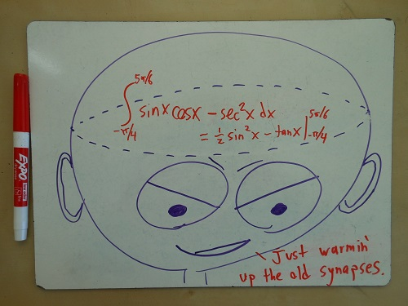
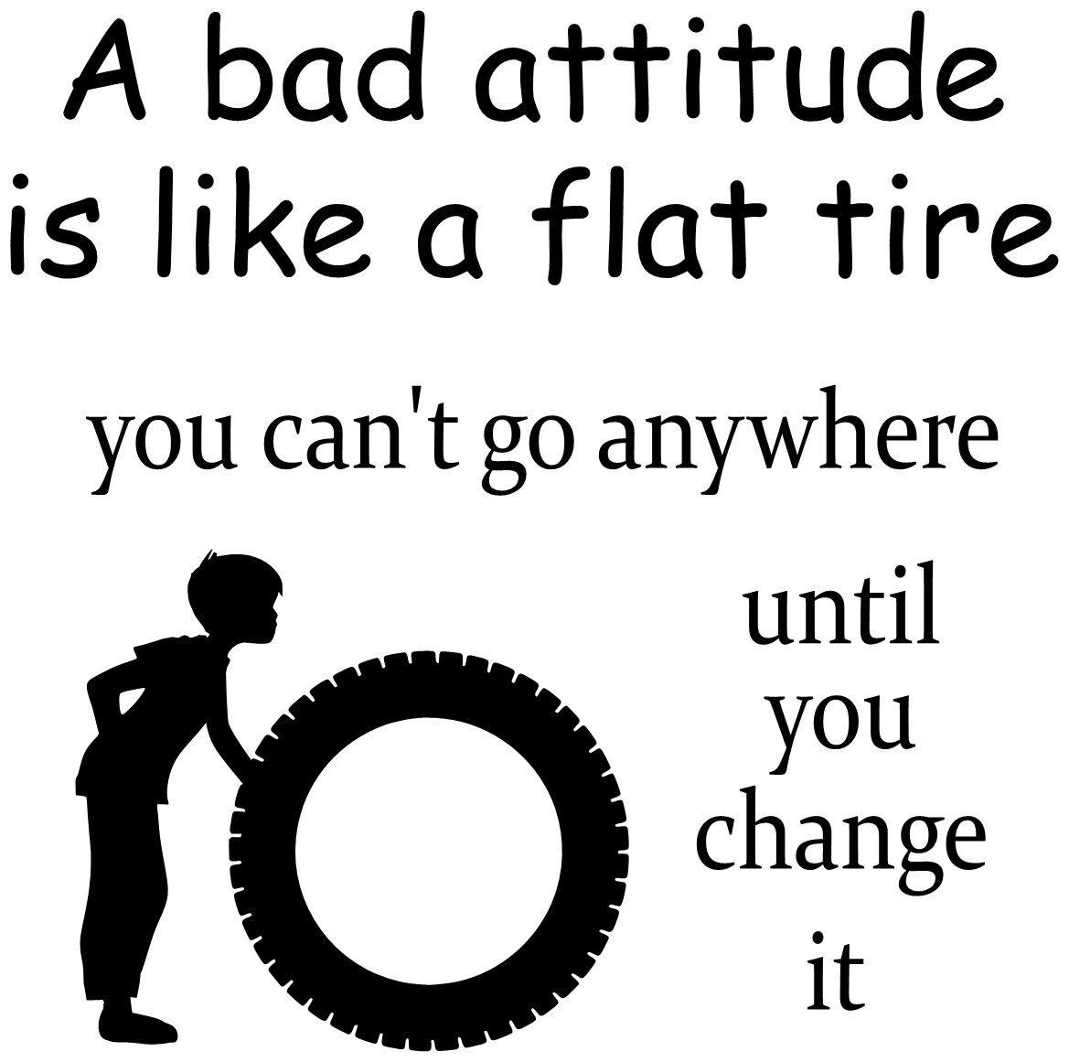
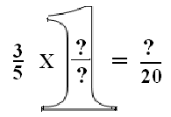
This Photo by Unknown Author is licensed under CC BY-SA-NC
Notes:
ALL these FACTORS Add up

Slide 15
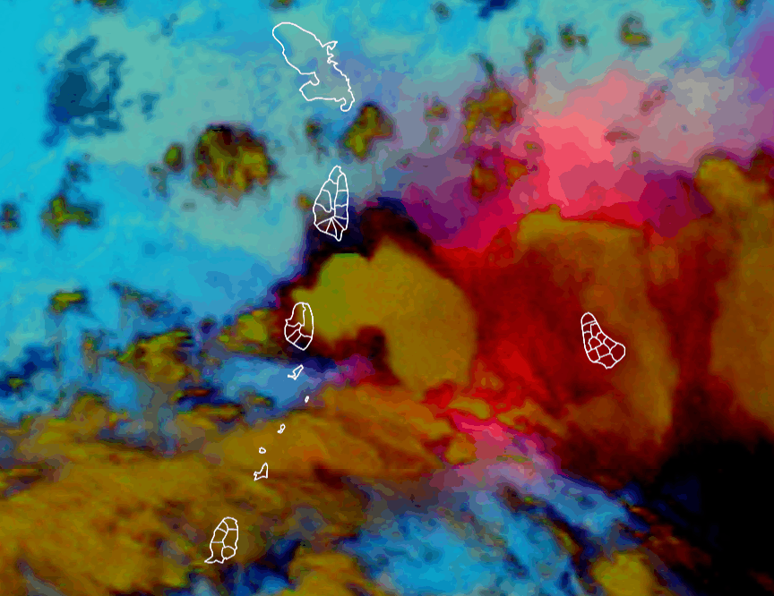
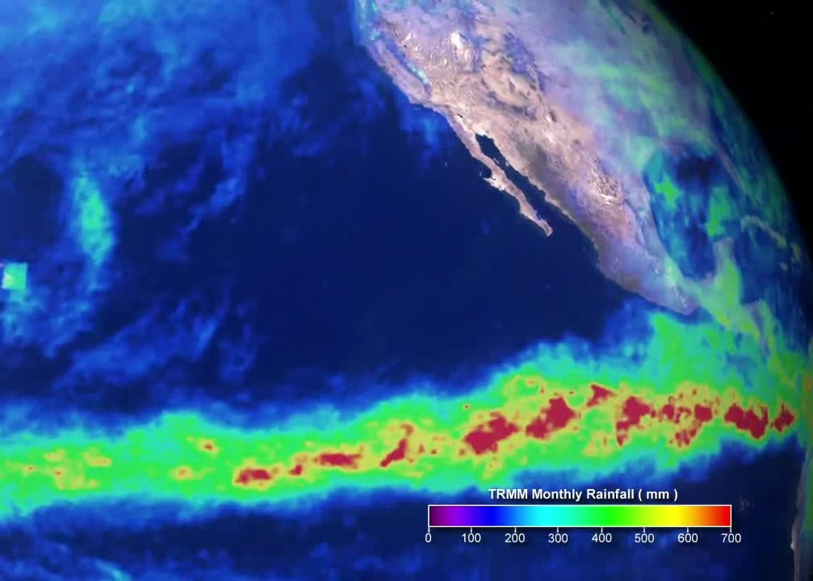
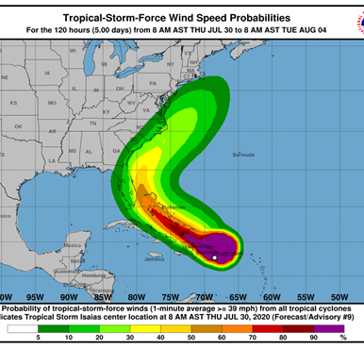
5 - Planned Short Courses and Workshops
Successful Workshop on Severe Weather Forecasting Pragramme – Future training includes in-country training exchanges;
Need to support the training of personnel in non-forecasting meteorological services in the area of Hurricane Forecasters Competencies.
After the La Soufriѐre Volcanic Eruption and extensive Ash event, we have made requests for CIRA to support a training event on the use of satellite imagery to diagnose and track Ash clouds.
Launching of the recently designed Marine Course for Operational Forecasters.
At CIMH we are still noting MAJOR issues with prepared TAFS from regional NMHS –
More CPD training
The New CIMH TAFv to be launched by mid-2022
This Photo by Unknown Author is licensed under CC BY-SA
Notes:
the Section provides significant support to the disaster risk management sector in areas of impact-based forecasting and pre-event evidence-based scenario development and analysis.

Slide 16
Challenges identified by staff
“On the fly” approaches to solving new challenges in teaching and learning in a virtual environment due to the current pandemic.
Mental and physical fatigue is becoming an increasing problem.
The time taken to complete certain tasks has now tripled in a virtual environment and hence entitled vacation leave is compromised.
COVID fatigue.
Over the years at CIMH, the heavy teaching load and other responsibilities have hampered time available to do research and write papers for publication
Lack of quality administrative support.
The continuing instability of the training brought about by the COVID Pandemic.
The role of being the main training section has multiple facets which incorporates multiple layers of administration
Teaching challenges with a growing population of weak students, who are at the same time entitled.
Lack of time to invest in research and publishing papers.
- LACK OF TECHNCAL SUPPORT AND TIME TO CREATE/DESIGN - CARIBBEAN CLIMATOLOGY AND METEOROLOGY ONLINE TOOLKIT (CCMOT) DESIGN OF TOOLKIT
Need for access various software app (cost maybe issue).

Slide 17
WE NEED YOUR SUPPORT
Continue to send the UPDATED NHMS Training Plans
Please sensitize staff BEFORE TRAINING STARTS on the need to be prepared and focused
Provide the basic technical support – as simple as an internet cable can resolve internet issue
Recognize that students are actively in ‘class’
Protect your investment – ensure students participate
Notes:
Continue to send the UPDATED nhms Training Plans – Send or discuss with CIMH your training needs and plans
Please sensitize staff BEFORE TRAINING STARTS on the need to be prepared and focused – let them know the importance of their training
Provide the basic technical support – as simple as an internet cable can resolve internet issue – See Academic Training Requirements List
Recognize that students are activity in ‘class’ – NO CALLING OUT TO WORK PLEASE!
Protect your investment – ensure students participate – back up CIMH when discipline is needed

Slide 18
Standard of Training
Need to THANK Meteorology Section Staff and the many of the CIMH staff as a whole – through – Classes went on
Ash fall
Severe storms
Hurricane
COVID
Despite the obvious fatigue CIMH continues to maintain International Standards
Thanks to Dr Farrell for his tireless and continued support
A Promise – STANDARDs WILL NOT COMPRISED
This Photo by Unknown Author is licensed under CC BY-NC-ND
Notes:
The staff should be complimented as well for ensuring that all the teaching obligations were met during a time when there were not only complications brought about by COVID-19, but also major weather events such as the volcanic eruption and subsequent ash fall over Barbados, from April 9th to April 12th; the severe weather event of June 17th, and the passage of Hurricane Elsa on July 02nd. These events led to serious disruptions to the normal daily activities that could have stop the duties, but all classes proceeded without fail.

Slide 19
Click here to access the Meteorology Section individual 2021 annual reports.

