Slide 1
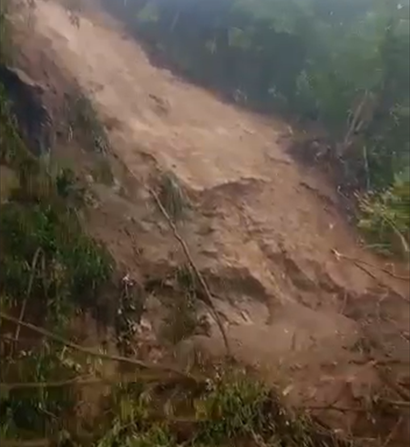
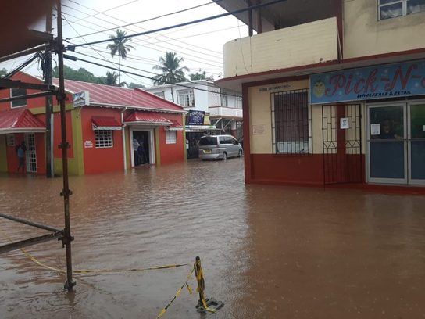
DIRECTORS OF METEOROLOGICAL SERVICES MEETING CMC 61
ABOVE NORMAL RAINFALL & CASCADING EVENTS
Virtual Presentation by: Cécil Mitchell Ms., MSc.
Meteorologist, Grenada MET Service 17th November 2021

Slide 2
PRESENTATION SCOPE
Climatology –Emerging trends
Rainfall
Maximum temperature
Minimum Temperature
Severe weather (Pre- Hurricane Season)
Hurricane Season
Conclusion
Acknowledgements

Slide 3
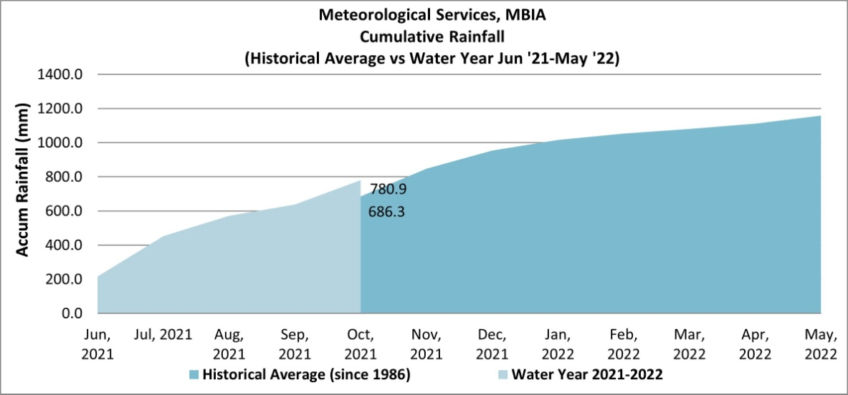
Comparing the last Water Year with the Current
Last Water Year ended below the historical average
By the end of October 2021, the cumulative rainfall was above the historical average.

Slide 4
Tmax (2020-2021)

Slide 5
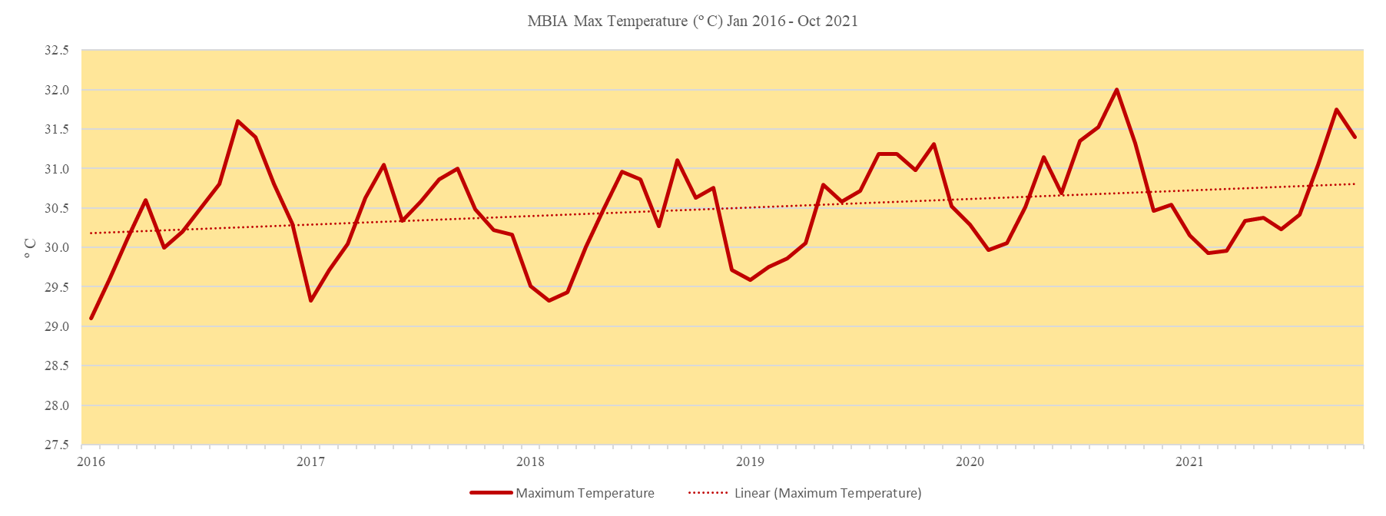
Trends in tmax
5 year analysis signals a positive warming trend

Slide 6
Tmin (2020-2021)

Slide 7
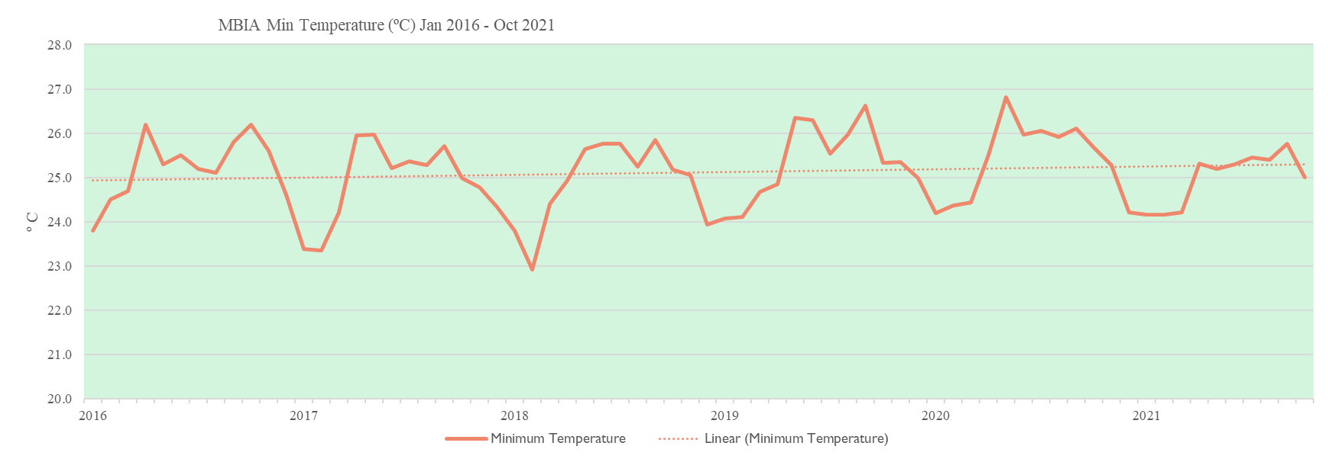
Trends in min temperatures
5 year analysis signals positive warming trend

Slide 8
FLOOD & LANDSLIDE DAYS 2021 Increasing….
31 Jan.
Southward draping frontal system/
4 May
Upper -Level trough moisture advection
8 May
Upper - Level trough Moisture advection
24 June
Deep-layered moisture advection
30 June
Tropical wave
2 July
Hurricane Elsa
28 July
Moisture surge
3 Sep.
Moisture surge trailing tropical wave
27 Sep.
Localized convective build up
13 Oct.
Convective build up north of the ITCZ

Slide 9
Severe weather trends
Increase in cascading events

Slide 10
Pre hurricane season severe weather events
Three events occurred
31st January
May 4th
May 8th

Slide 11
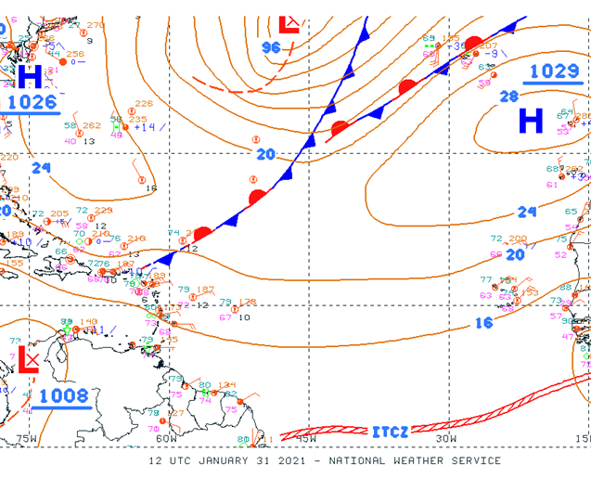
Gale force winds & hazardous seas
31st January, 2021
Southward draping frontal system triggered gale-force winds over the south-central Caribbean. Seas of 10 to 13 feet were experienced in the area.
Impacts: Coastal inundations along the west Coast and the Town of St. George’s.
Similar event occurred on Jan. 11th, 2020

Slide 12
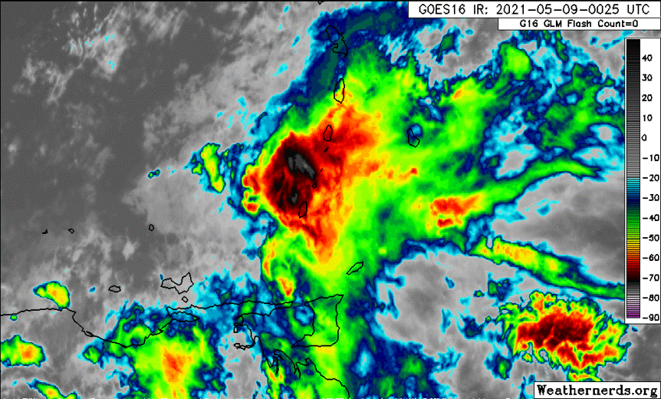
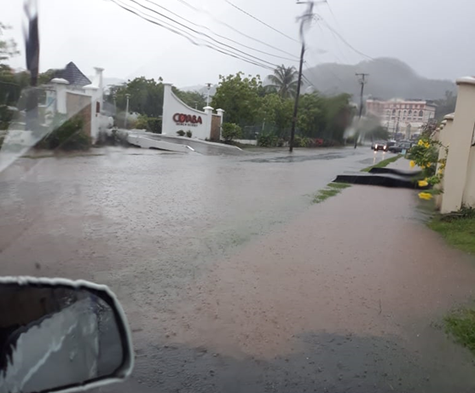
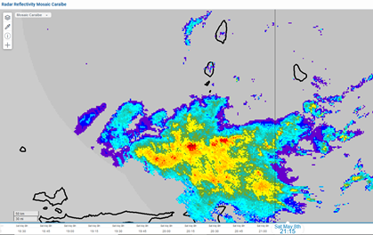
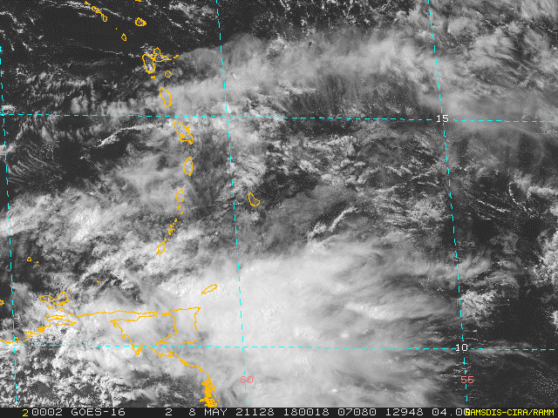
Transition month – Moisture Advection
An upper-level trough facilitated moisture advection from over South America into the southeast Caribbean.
Impacts: Flooding on May 04th , 5th & 08th .
MBIA acc rainfall -32.8mm (May 8th)
Annandale – 113.8mm , Mamma Cannes 95.4 mm (4th)
Annandale -66.6mm ,Mamma Cannes -49.4 mm (8th)

Slide 13
Atlantic Hurricane Season 2021
21 depressions
21 named storms
7 Hurricanes , 4 major hurricanes

Slide 14
Landslides
JUNE 24TH
A propagating tropical wave along with deep-layered moisture advection
induced cloudy conditions , triggered
torrential downpours overnight and landslides.

Slide 15
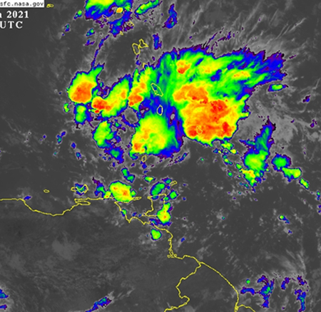
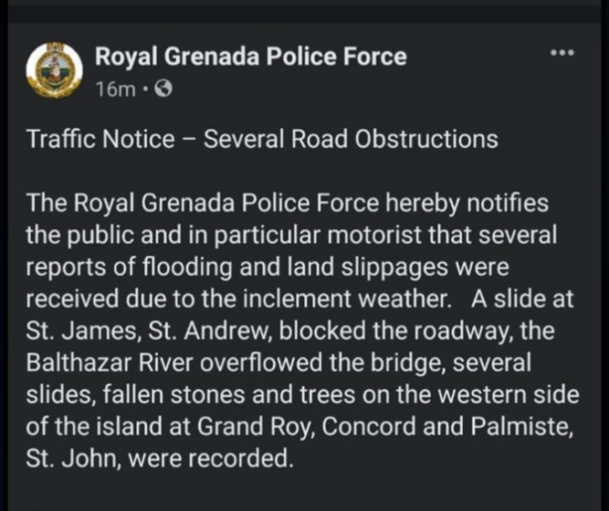
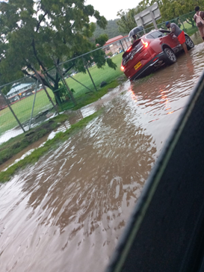
June 30th Flooding & landslides –
Balthazar River
Propagating tropical wave
triggered significant flooding
and landslides.
MBIA – Acc rainfall - 29.2mm
Morne Rouge

Slide 16
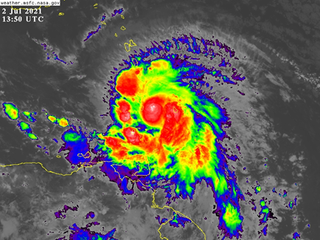
Hurricane Elsa- July 2nd
- The season’s 5th TS, Elsa, was earliest on record in any season.
The most significant system of 2021 Hurricane season that impacted Grenada.
Tropical Storm Watch was issued for Grenada on 1st July @ 8am .
As TS Elsa moved across the SE Caribbean, it intensified from TS to Cat I Hurricane while crossing the Lesser Antilles.

Slide 17
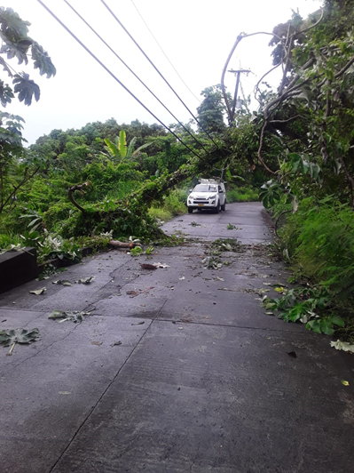
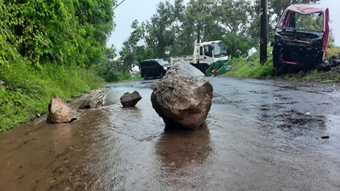
Hurricane Elsa Impacts
St. John’s River overflowed River Road , St. George
Brizan, St. George
Mt. Alexander, St. Andrew

Slide 18
Impacts of hurricane elsa
St. DAVID | ST. GEORGE | ST.JOHN | ST.ANDREW | ST. PATRICK
FLOODS
La Calome | Brizan | St. Peters Roman Catholic School | Grenville | Mt. Alexander
Confer | Lagoon Road |  | Balthazar Bridge
Westerhall, | Beausejour
 | Egmont
 | Grand Anse
 | Happy Hill
 | JW Flecther Secondary School
 | Morne Rouge
 | Tanteen
 | Mt. Gay
 | Calivingy
 | River Road
LANDSLIDES
 | Mt. Gay | La Digue |  | Mt. Alexander
 | General Hospital Steps | St. James

Slide 19
RAINFALL ACCUMULATION Hurricane Elsa
LOCATIONS | RAINFALL ACCUMULATION (mm) | RAINFALL ACCUMULATION (ins)
NORTHERN GRENADA
Marli | 41.8 | 1.6
Peggy’s Wim | 70.2 | 2.8
Levera | 41.6 | 1.6
SOUTHERN GRENADA
Cardi Agro Met | 90.8 | 3.6
MBIA | 79.7 | 3.1
Botanical Gardens
Laura Land | 71.6 | 2.8
Cruise Terminal | 22.8 | 0.9
WESTERN GRENADA
Maran | 65.0 | 2.6
Mt. Plaisir(Grand Roy) | 90.0 | 3.5
Union | 55.0 | 2.2
Clozier | 107.6 | 4.2
EASTERN GRENADA
Mamma Cannes | 80.8 | 3.2
Mirabeau | 68.4 | 2.7
RAIN FOREST
Grand E’tang Park | 84.2 | 3.3
Grand E’tang Lake | 86.0 | 3.4
CARRIACOU
Airport | 28.8 | 1.1
Belair | 29.8 | 1.2
PETITE MARTINIQUE
Petite Martinique | 15.6 | 0.6

Slide 20
HURRICANE ELSA RAINFALL DISTRIBUTION

Slide 21
Hurricane elsa Impacts
Torrential rains from the outer spiral bands resulted in the following:
Numerous floods and landslides.
Impassable roads leading to disruptions to human and vehicular movement in most parts of the country.
A number of NAWASA’s water supply systems were also affected.
Fortunately , there were no reports of fatalities, injured or missing persons.
There was no major structural damage reported apart from the landslides. Most of the roads were motorable within two days and all the landslides were cleared within two weeks.
The clearing of the landslides was done by the Ministry of Infrastructure at a cost of EC$108,993.00

Slide 22
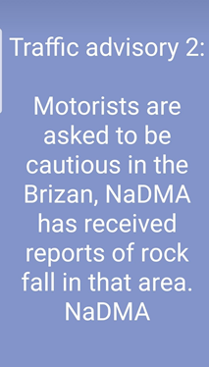
Hurricane Elsa impacts

Slide 23
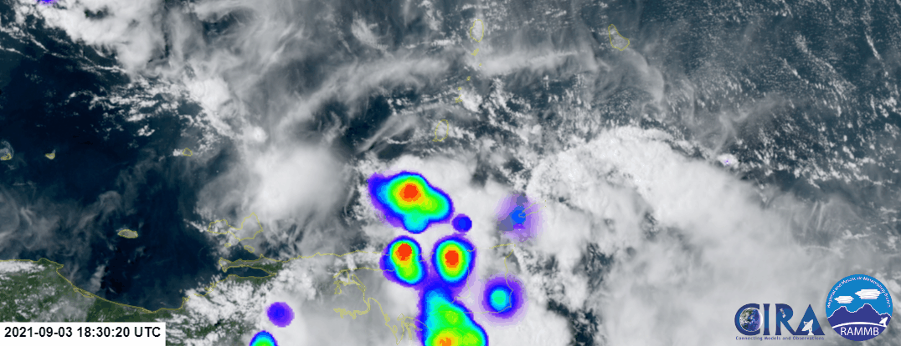
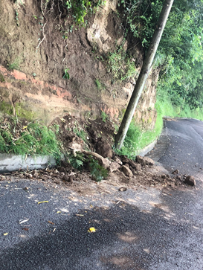
September 3rd
River Road, St. George
A Tropical wave fueled by ITCZ moisture
Acc. Rainfal MBIA- 38.9mm
Brizan, St. George

Slide 24
October 13th – Flooding & landslides
La Sagesse, St. David’s
Convective buildup from the northward migration of ITCZ
MBIA rainfall acc-38.9mm

Slide 25
Dense haze/ ash events
2 significant events
11th April - Invasion of Saharan dust coupled with La Soufiere Volcanic ash deposits.
28th to 31st October – Intrusion of Saharan dust coupled with ash/ sulphur dioxide from the eruption of Cumbre Vieja , La Palma Volcano.

Slide 26
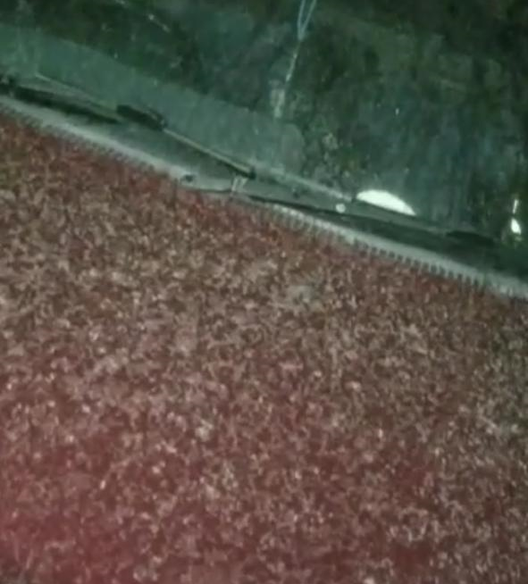
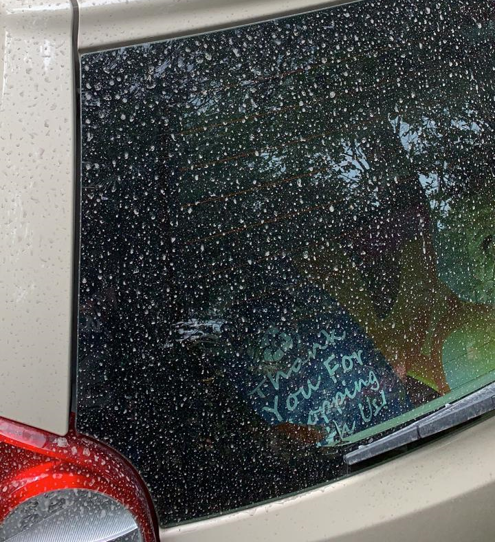
Ash deposits 9TH - 11TH April 2011

Slide 27
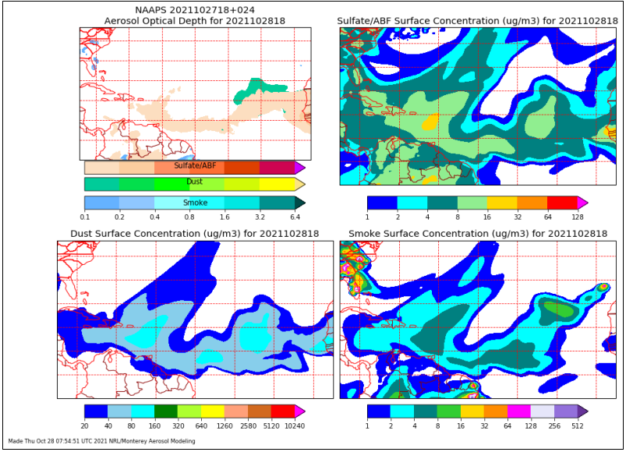
Dense dust haze & ash
St George’s 28th October , 2021
Visibility reduced to 5km and less across the island

Slide 28
MITIGATION AGAINST FLOODING
Gov't of Grenada has embarked on St. John's River Flood Mitigation Project
Cost: EC $23 million
Duration: August 2021 - 2022
Progress of the project: To date a series of retaining walls have been constructed to increase capacity in the channel.

Slide 29
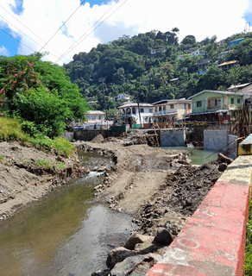
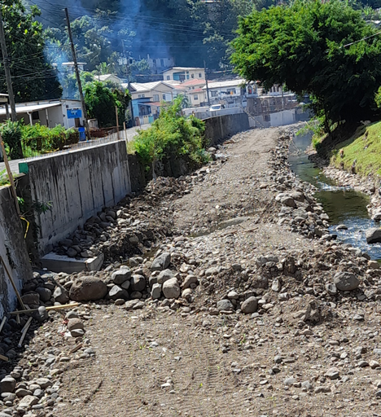
St. John's River Flood mitigation project

Slide 30
Conclusion
Temperature trends (Maximum and minimum) signal warming
Increase in severe weather events; cascading events for 2021
Response : Increase monitoring and build Multi hazard early warning systems (MHEWS)
Implementation of CAP

Slide 31
acknowledgements
We express our sincere gratitude to the following:
World Meteorological Organisation (WMO)
National Hurricane Centre (NHC)
Caribbean Meteorological Organisation HeadQuarters (CMO)
Caribbean Institute for Meteorology and Hydrology(CIMH)
Trinidad and Tobago Met Service
Government of Grenada
Ministry of Tourism, Civil Aviation, Climate Resilience
& Environment
Grenada Airports Authority (GAA)
Manager of Meteorology, Mr. Hubert Whyte
Staff of Grenada MET Service
Thank you

